Slide 1

Clustering of London’s Crime Areas
By Alom Miah
24 April 2021

Slide 2
Getting to know London
The purpose of this project was to segment the different neighbourhoods of London by the different types of crime which occur. This would be of use to:
Residents of London - So they can protect themselves of such crimes.
Tourists - As above and for an awareness of what crimes to expect in different areas.
Businesses - As above and so they can take out appropriate insurance.
Insurance companies - Can set insurance premiums taking into consideration the prevalence of crime in a certain neighbourhood.
London was also be segmented by venues (from the Foursquare API) to see if there was a link to crime.

Slide 3
Data acqustion and cleaning
The Crime Data
Crime data was obtained using the UK Police's API/Crime Data, filtering the data from crimes in 2019 (to exclude impacts of Covid-19) by the Metropolitan Police Service which is London's police force. The crime data came as monthly csv files which was combined for the year of 2019.
Documentation on the API can be found on: https://data.police.uk/docs/ and https://police-api-client-python.readthedocs.io/en/latest/ and Crime Data from https://data.police.uk/data/
The crime data had to be cleaned as there were 1,108,042 reported crime incidents to the Metropolitan Police in 2019 but only 1,093,359 reported crime incidents actually took place in London .
Foursquare Data
Using the crime Neighbourhood data the Foursquare API was be used to get info on venues in each neighbourhood.
The number of venues were found within a radius of 2km from each neighbourhood crime centroid. As we are looking at the crime centroid of each neighbourhood we want to see if nearby venues have an association with the crimes committed.

Slide 4
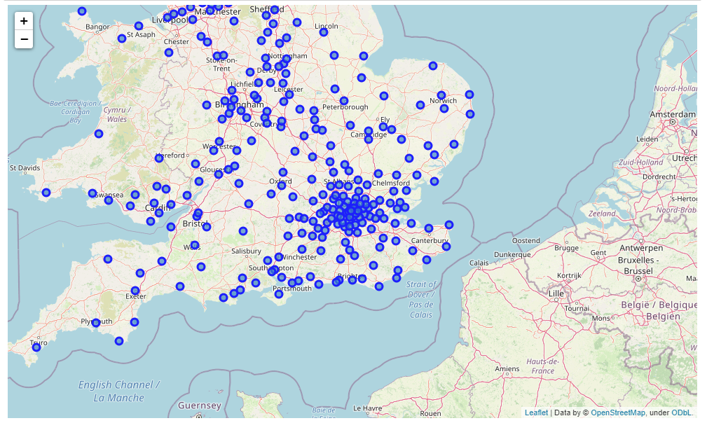
Crime Neighbourhoods Before Cleaning Data

Slide 5
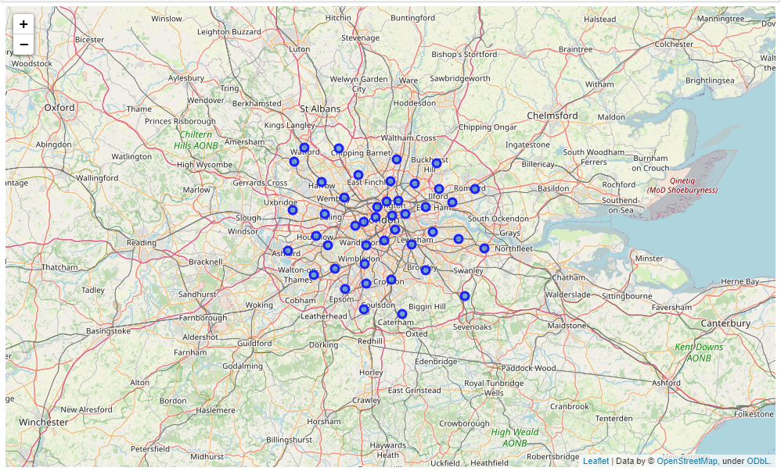
Crime Neighbourhoods After Cleaning Data

Slide 6
Methodology
For this project we looked to segment the different neighbourhoods of London by the most prevalent crime in that area.
In the first step we collected the crime data from the Metropolitan police and cleaned this data for crime that only occurred in London.
In the second step, we clustered the neighbourhoods by the most prevalent crimes in the area.
In the third step, we obtained venue data from the Foursquare API for venues near each neighbourhood centroid.
In the fourth step, we clustered the neighbourhood by the most prevalent venues.
In the fifth and final step, we compared the crime and venue clustered neighbourhoods to see if there is any similarity.

Slide 7
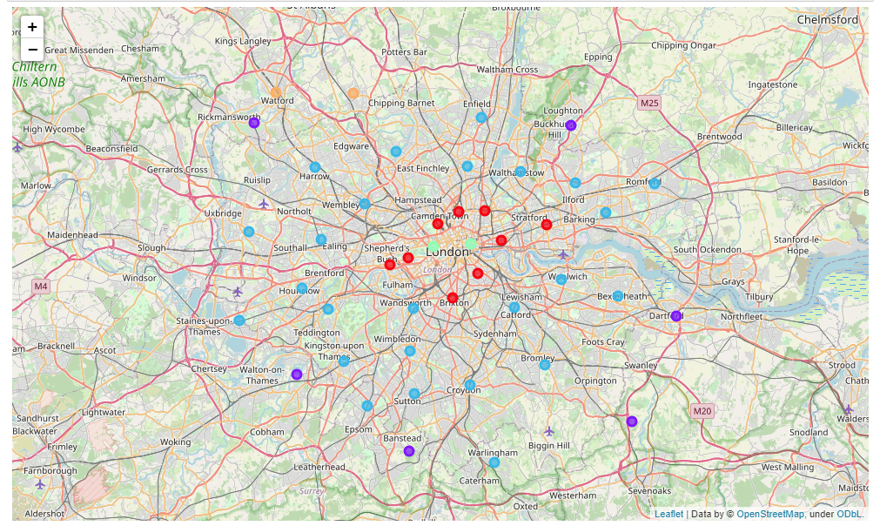
Results and discussion - Crime Data
It appeared that the clusters for crime in London vary radially from the centre of London.
With Central London being the centre of thefts and as you move outwards you find anti-social behaviour morphing into more violent crime.

Slide 8
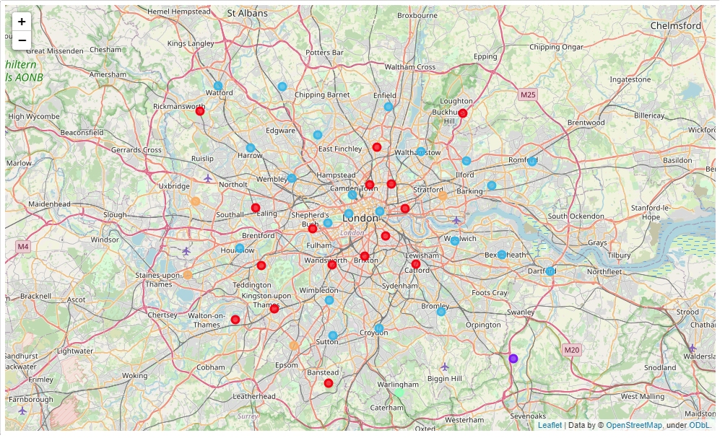
Results and discussion - Venue Data
It appeared that there was no clear geographic link between neighbourhood location in London and the clustering of venues.

Slide 9
Conclusion and suggestions
From the mapped crime data we found that crime in London varies radially from the centre of London. With Central London being the centre of thefts and as you move outwards you will find anti-social behaviour morphing into more violent crime.
Clustering and looking at venues near the crime centroids of each neighbourhood there was no clear linkage between the crime location clusters and venue clusters and so it is unlikely that the clustering of venues gives rise to crime but more the opportunity at a geographic location and the people who live and work there.
The venue data did however typically indicate pubs being the closest venue to the crime centroid of most neighbourhoods which makes sense as drinking does not lead to the best decisions.
Therefore, stakeholders can conclude that crime will most likely increase around locations containing pubs and in order to compensate for this local government should ensure establishments have the correct licences in place in order to compensate for potentially higher insurance costs and the need for more police presence.

